Slide 1
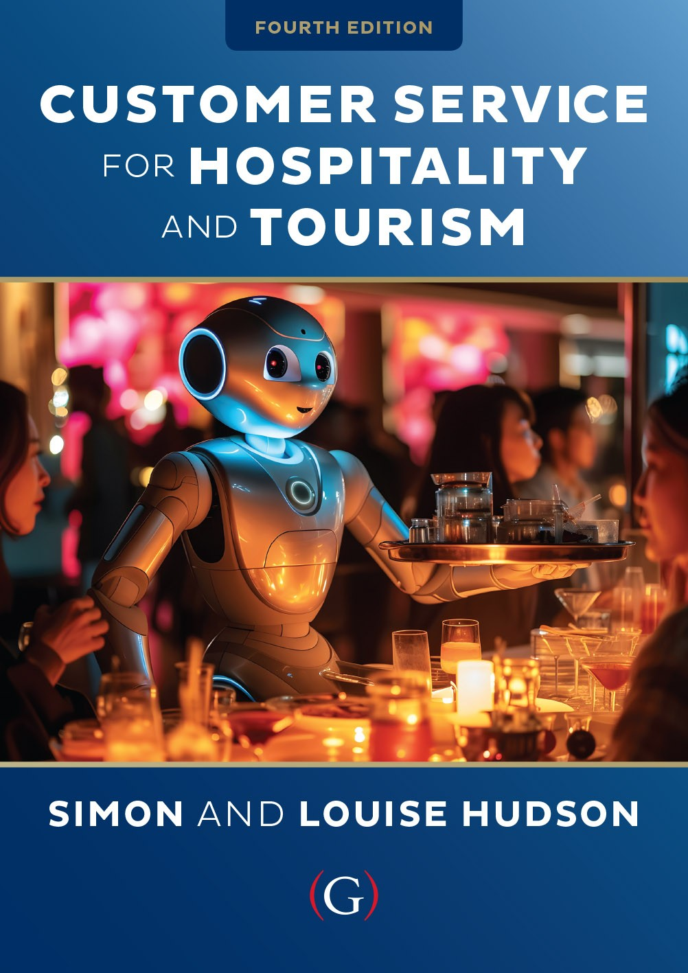
Chapter 10
The importance of service recovery

Slide 2
Topics Covered
Definition of service recovery and recent studies
Service recovery paradox
The recovery process
Consequences of an effective recovery process
Guidelines for soliciting, tracking and handling complaints
Service guarantees

Slide 3
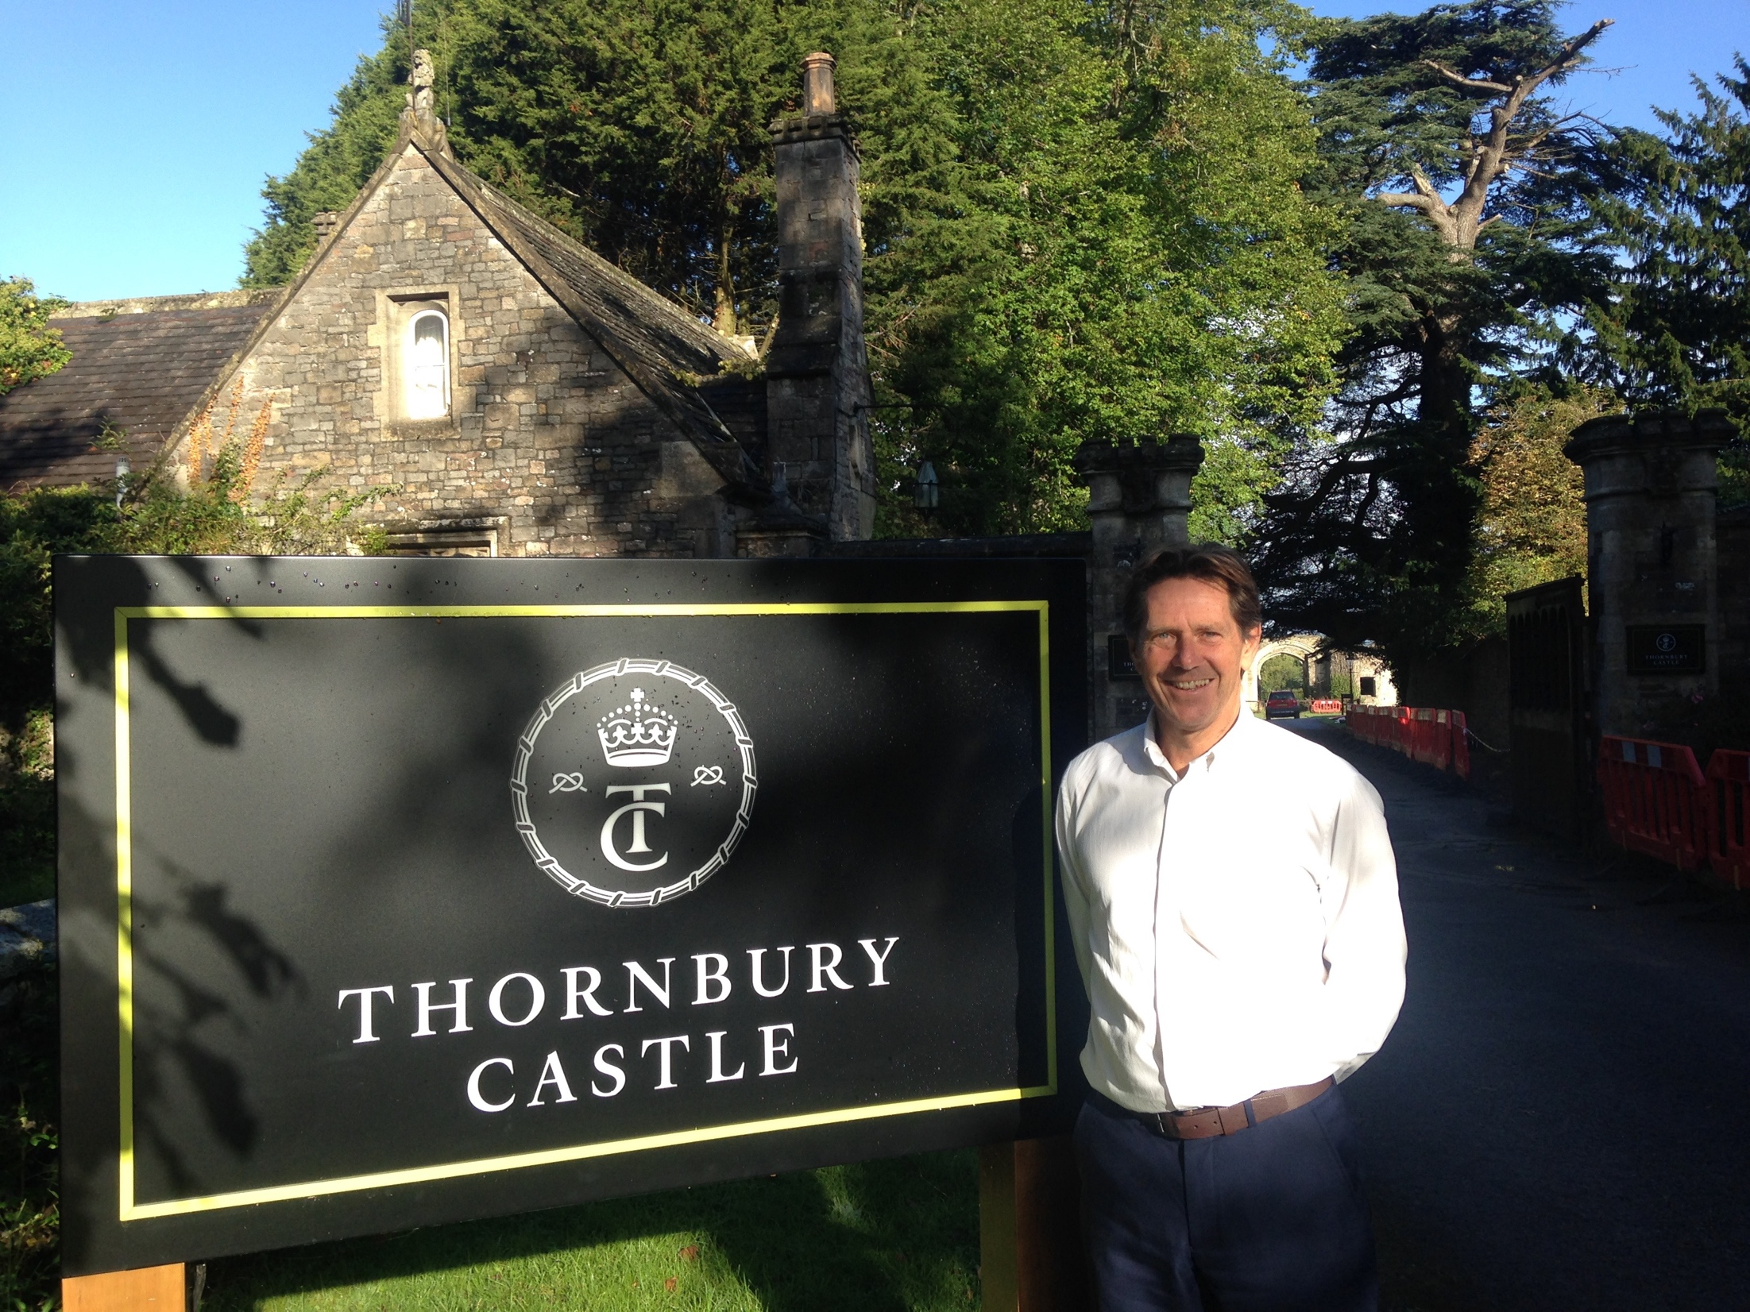
‘At Your Service’ Spotlight:
Solving problems for travelers
Fix it, plus one.
No ‘passing the buck’
  Positive feedback and word of mouth
Anticipating service problems
Service recovery training
  Case studies, role plays, letters of complaints
Solve immediate problem and ‘a bit extra’
Encourage guest feedback
  Determine what the customer values
  Determine future prevention strategies

Slide 4
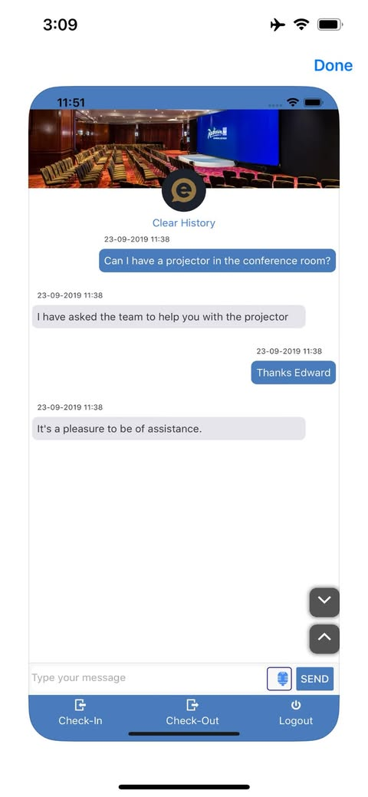
Service recovery
Service recovery is defined as the process by which a company attempts to rectify a service delivery failure.
Several studies of hotel customers have found that their level of satisfaction and lasting impression are based first and foremost on what happens when something goes wrong
Research that explicitly addresses complaining behavior and service recovery is evolving
More recently, research has focused on the use of artificial intelligence (AI) technologies in service recovery, which is transforming the frontline interfaces across tourism and hospitality

Slide 5
The service recovery paradox
Figure 10.1 (Source: Adapted from Schindlholzer, 2008)

Slide 6
Service recovery process
Apology
  Frames customer’s perceptions and paves the way to recovery
Urgent reinstatement
  Quick action to correct or remove problem
Empathy
  Employee understanding and responsiveness
Symbolic atonement
  Tangible evidence of organization’s willingness to take responsibility
Follow-up
  Evaluate recovery plan

Slide 7
The consequences of an effective recovery process
Service failures
  ‘Customer Complaint Iceberg’
  Damage to employee morale
Effective service recovery
  Impacts customer satisfaction
  Impacts perceptions of quality
  Impacts bottom-line performance
  Enhances customer loyalty
  Stimulates positive word of mouth

Slide 8
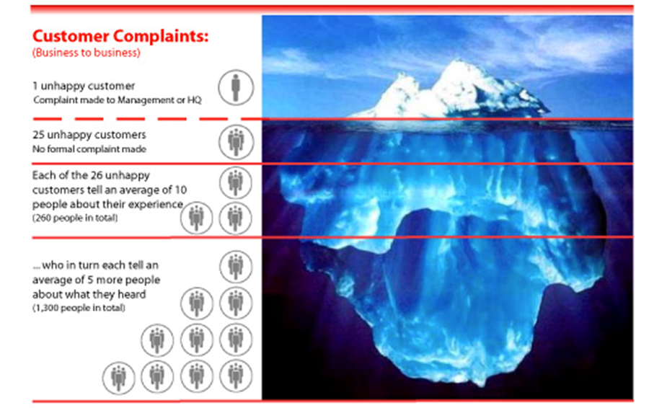
The Customer Complaint Iceberg
Figure 10.2 (Source: based on TARP, 1979)

Slide 9
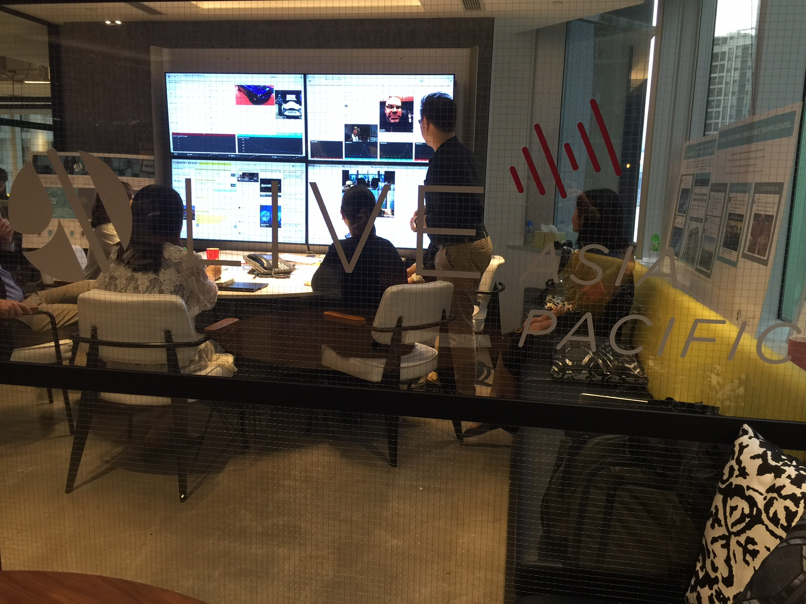
Service Snapshot: Social media listening aids service recovery
In today’s very fast evolving marketplace you can’t talk so much but you have to listen more’
Organizations are increasingly using ‘social media listening’ to respond to consumer complaints (eg. Southwest, Marriott, G Adventures, Expedia).
Efficient means by which customers can be heard
Effective and timely problem solving
  Enhancing transparency of service culture
  Improves speed of resolution and recovery
Companies are ‘part of the conversation’

Slide 10
Soliciting, tracking and handling complaints
Make it easy for customers to complain
  Solicit complaints through multiple channels
Respond quickly to complaints
Employee education and empowerment
  Strategic and financial value of complaints
  Appropriate coping and problem-solving skills
Complaints viewed as operational problems, strategic opportunities
Make complaints and complainers visible
Align quality measures, performance reviews, compensation
Reward complainers
Stop calling them ‘complainers’!

Slide 11
Reasons and criteria for service guarantees
Table 10.1 (Source: based on Hart, 1990; Zeithaml et al, 2007)

Slide 12
Service guarantee impacts on marketing and operations
Figure 10.3 (Kandampully and Duddy, 2001, pp. 36)

Slide 13
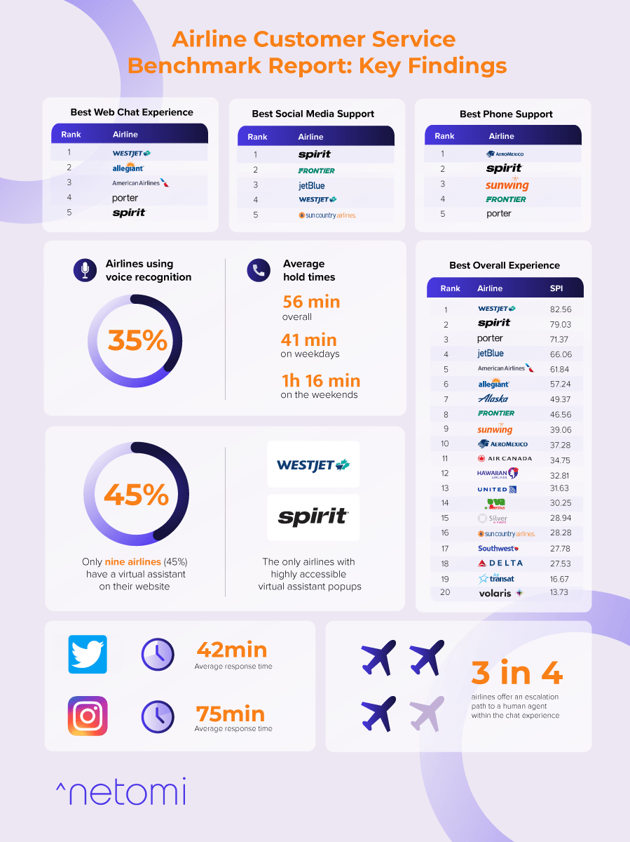
Case Study:
Airlines falling short in service recovery efforts
Netomi set out to analyze the true state of customer service for the top 20 passenger airlines in North America.
Their research team examined support delivered across three key customer service channels – web-chat, social media and phone - and the findings are summarized in the infographic
Consistency and support quality varied greatly by airlines across the different service channels, but when Netomi looked holistically at availability, responsiveness, response time, personalization, relevance, and empathy, WestJet (featured in Chapter 4 of this book) performed the best across all channels.

